Slide 1

Slide 1
THE ELECTRIFYING FUTURE
A Deep Dive into Electric Vehicles

Slide 2
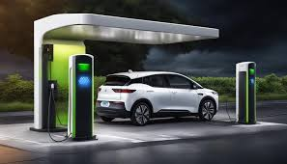

Slide 3

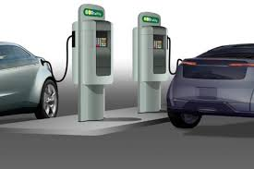
Slide 1
ABDUL RAUF COHORT 12 https://www.linkedin.com/in/ardamani/

Slide 4
Slide 1
TIMELINE
EVOLUTION OF EVS

Slide 5
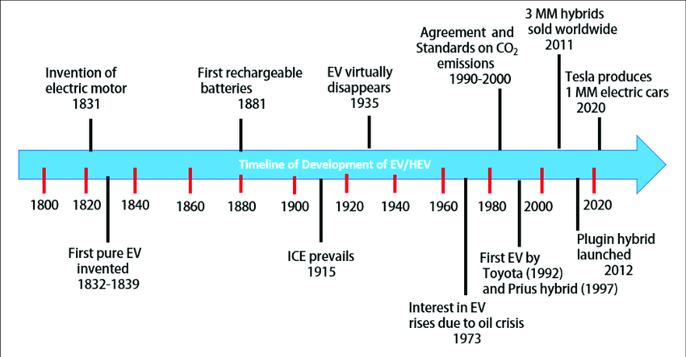

Slide 6
Slide 1
TYPES OF ELECTRIC VEHICLES

Slide 7
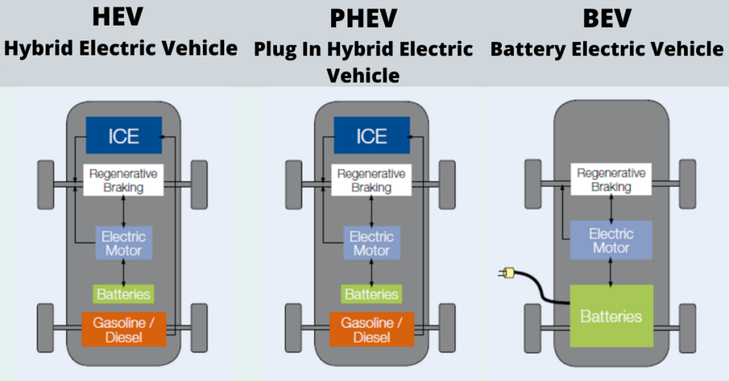

Slide 8
Slide 1
COMPARISON OF EV TYPES

Slide 9
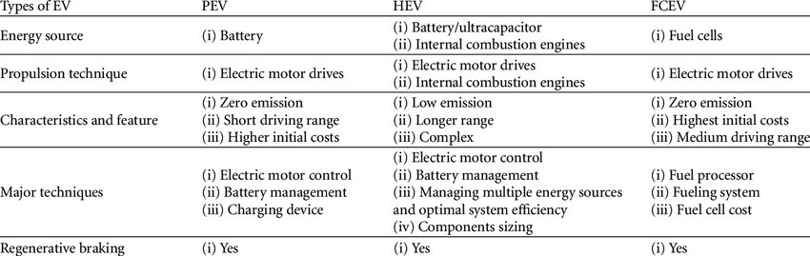

Slide 10
Slide 1
GLOBAL EV TRENDS

Slide 11
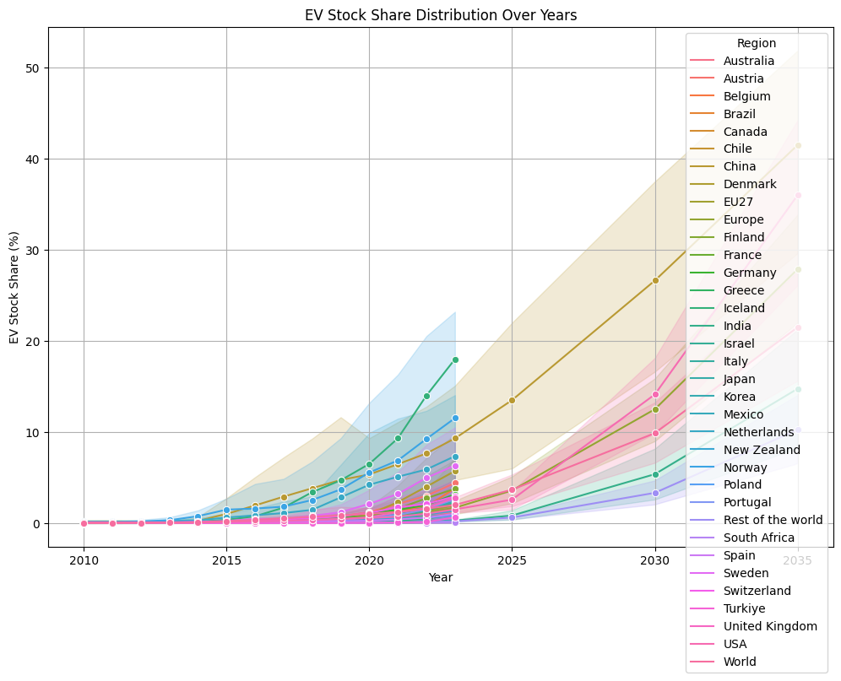

Slide 12
Slide 1
DATA VISUALIZATION

Slide 13

https://www.kaggle.com/datasets/abdulraufdamani/ev-sales-2010-2024/data

Slide 14
Slide 1
INSIGHTS & PROBLEM STATEMENT

Slide 15
KPI’S REQUIREMENT
TOTAL VEHICLES
UNDERSTAND THE OVERALL LANDSCAPE OF ELECTRIC VEHICLES, ENCOMPASSING BOTH BEVS AND PHEVS, TO ASSESS THE MARKET'S SIZE AND GROWTH
The electric vehicle (EV) market, encompassing both Battery Electric Vehicles (BEVs) and Plug-in Hybrid Electric Vehicles (PHEVs), has experienced significant growth over the past decade
Market Segmentation
Battery Electric Vehicles (BEVs) Plug-in Hybrid Electric Vehicles (PHEVs)
Market Size and Growth
Global Sales

Slide 16
KPI’S REQUIREMENT
AVERAGE ELECTRIC RANGE
DETERMINE THE AVERAGE ELECTRIC RANGE OF THE ELECTRIC VEHICLES IN THE DATASET TO GAUGE THE TECHNOLOGICAL ADVANCEMENTS AND EFFICIENCY OF THE EVS
Determine the average electric range of EVs in a dataset
Collect Data Gather EV models and their electric ranges.
Calculate Average Sum the electric ranges and divide by the number of vehicles.
Analyze Compare the average range with previous years to gauge advancements in battery technology and efficiency
This metric helps assess how EV technology is evolving and its impact on consumer adoption

Slide 17
KPI’S REQUIREMENT
Total BEV Vehicles and % of Total BEV Vehicles
Identify and analyze the total number of Battery Electric Vehicles (BEVs) in the dataset.
Calculate the percentage of BEVs relative to the total number of electric vehicles, providing insights into the dominance of fully electric models
To analyze BEVs in a dataset
Identify BEVs Count the total number of BEVs.
Calculate Percentage Divide the number of BEVs by the total number of EVs, then multiply by 100.
This percentage shows the dominance of fully electric vehicles in the market.

Slide 18
KPI’S REQUIREMENT
Total PHEV Vehicles and % of Total PHEV Vehicles
Identify and analyze the total number of Plug-in Hybrid Electric Vehicles (PHEVs) in the dataset.
Calculate the percentage of PHEVs relative to the total number of electric vehicles, offering insights into the market share of plug-in hybrid models.
To analyze the number of Plug-in Hybrid Electric Vehicles (PHEVs) in a dataset
Identify PHEVs Count the total number of PHEVs in the dataset.
Calculate Percentage Divide the number of PHEVs by the total number of EVs (including both BEVs and PHEVs), then multiply by 100.
This percentage shows the market share of plug-in hybrid models, providing insights into their presence relative to fully electric vehicles.

Slide 19
CHARTS REQUIREMENT
Total Vehicles by Model Year
(From 2010 Onwards)
Visualization: Line Chart
This chart will illustrate the distribution of electric vehicles over the years, starting from 2010, providing insights into the growth pattern and adoption trends.
To create a line chart showing EV distribution from 2010 onward
Collect Data: Gather annual EV sales or registration numbers.
Plot Data: Use "Year" on the x-axis and "Number of EVs" on the y-axis.
Analyze: The chart will reveal growth patterns and adoption trends over time.

Slide 20
CHARTS REQUIREMENT
Total Vehicles by State
Visualization: Map Chart
This chart will showcase the geographical distribution of electric vehicles across different states, allowing for the identification of regions with higher adoption rates.
To create a chart showing the geographical distribution of electric vehicles (EVs) across different states:
Collect Data: Gather EV counts for each state.
Choose a Chart Type: A bar chart or a choropleth map is ideal for showing regional distribution.
Plot Data: Use states on the x-axis (or as regions on a map) and the number of EVs on the y-axis (or as color intensity).
Analyze: The chart will highlight states with higher EV adoption, identifying key regions leading in EV usage.

Slide 21
CHARTS REQUIREMENT
Top 10 Total Vehicles by Make
Visualization: Bar Chart
Highlight the top 10 electric vehicle manufacturers based on the total number of vehicles, providing insights into the market dominance of specific brands.
To highlight the top 10 electric vehicle (EV) manufacturers based on the total number of vehicles
Collect Data: Gather data on the total number of EVs produced by each manufacturer.
Rank Manufacturers: Sort the manufacturers by the total number of EVs in descending order.
Select Top 10: Identify the top 10 manufacturers with the highest production numbers.
Analyze: This will reveal market dominance, showing which brands are leading in EV production.
A bar chart can be used to visualize the data, with manufacturers on the x-axis and the number of EVs on the y-axis.

Slide 22
CHARTS REQUIREMENT
Total Vehicles by CAFV Eligibility
Visualization: Pie Chart
Illustrate the proportion of electric vehicles that are eligible for Clean Alternative Fuel Vehicle (CAFV) incentives, aiding in understanding the impact of incentives on vehicle adoption.
To illustrate the proportion of electric vehicles (EVs) eligible for Clean Alternative Fuel Vehicle (CAFV) incentives:

Slide 23
CHARTS REQUIREMENT
Top 10 Total Vehicles by Model
Visualization: Tree map
Highlight the top 10 electric vehicle models based on the total number of vehicles, offering insights into consumer preferences and popular models in the market.
The top 10 electric vehicle (EV) models by sales are:
Insights: Tesla dominates, with strong interest in electric SUVs and a focus on affordability and range.

Slide 25

Slide 11
THANK YOU

